Slide 1



Retail Analysis
CAPSTONE
PROJECT

Slide 2
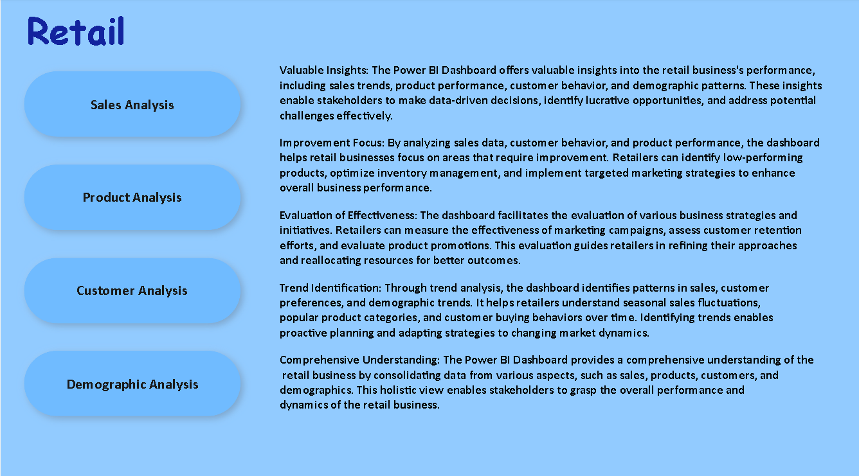

Slide 3
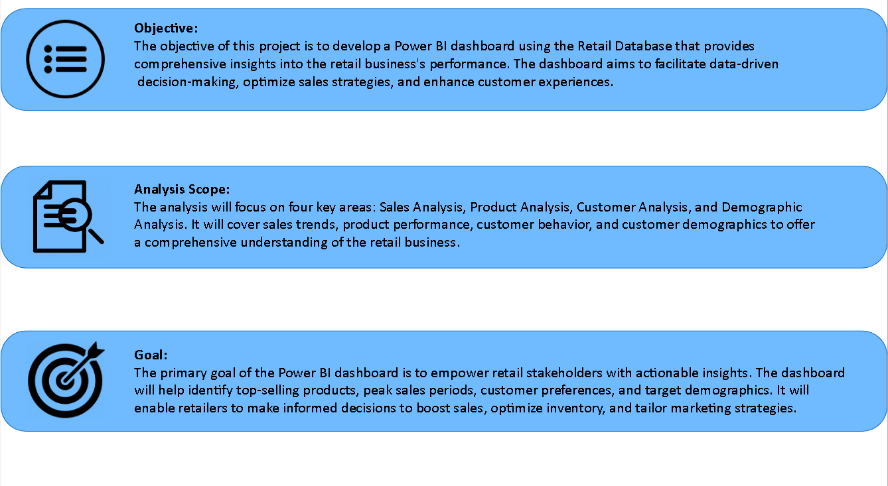

Slide 4
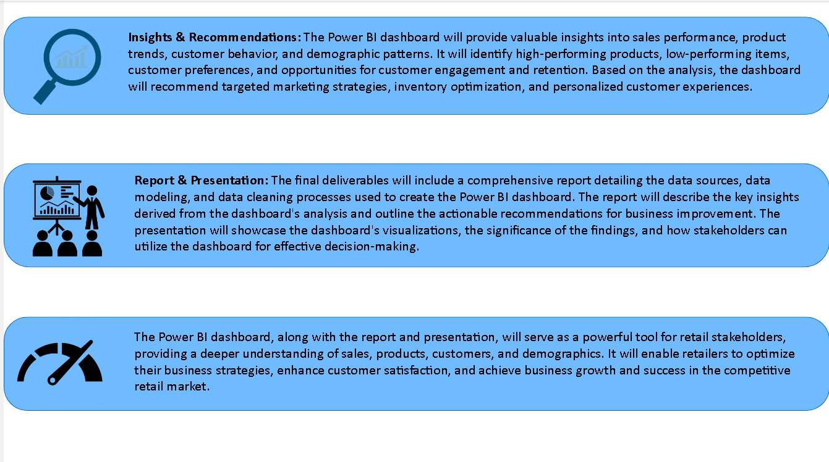

Slide 5


DATA DICTONARY
Table: Office
Fields:
office Code: Unique identifier for each office.
City: City in which the office is located.
State: State in which the office is located.
Country: Country in which the office is located.
Territory: Territory in which the office is located.
Table: Employee
Fields:
Employee Number: Unique identifier for each employee.
first name: Name of employee.
last name: surname of employee.
office code: Identifying the office where the employee works.
reports to: the employee number of the person to whom the employee reports.
job title: job title of the employee.
Table: Customers
Fields:
Customer Name: a unique identifier for each customer.
contact last name: Last Name of contact.
contact first name: First name of contact.
phone: Contact number of Customers.
Address line: Address of the customer.
City: City name where customer belongs.
State: State name of the customers.
Country: Country name of the customers.
sales representative employee number: identifying the employee responsible for the customer.
credit limit: Credit limit for each customers.

Slide 6
Table: Product
Fields:
product code: Unique identifier for each product.
product name: name of the product.
product line: categorization of the product.
product description: description of products.
quantity in stock: Number of quantity available.
buy price: cost of each product.
MSRP: Manufacturer's Suggested Retail Price.
Table: Product Lines
Fields:
product line name: Unique identifier for each product lines.
text description: Description of product lines.
Table: Orders
Fields:
order number: a unique identifier for each order.
order date: Date of orders.
shipped date: Shipping date of orders.
order status: Using an ENUM for predefined statuses.
comments: Comments on shipped orders.
customer number: identifying the customer who placed the order (act as foreign key).
Table: Orders details
Fields:
order number: linking to the orders table (Unique identifier for each row).
product code: linking to the products table.
quantity ordered: Number of quantities ordered.
price per item: selling price for each item.

Slide 7
Table: Payment
Fields:
customer number: linking to the customer’s table.
payment date: date of payments.
check number: Check numbers for payments.
payment amount: Payment amount done by customers.

Slide 8
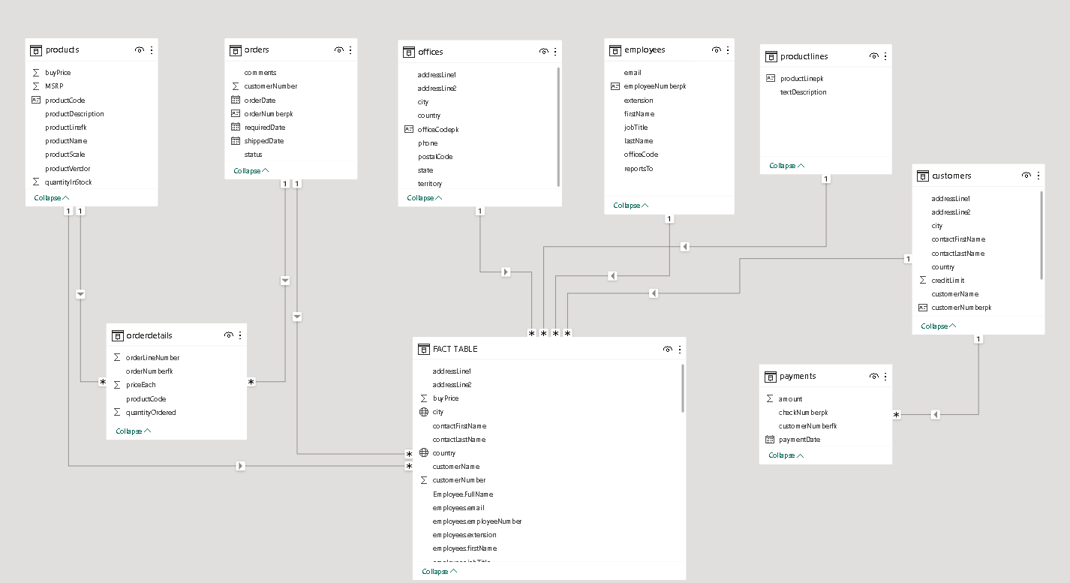
ER DIAGRAM

Slide 9
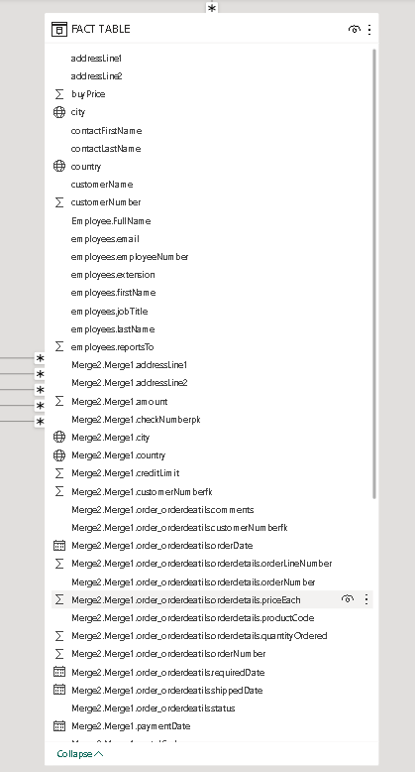
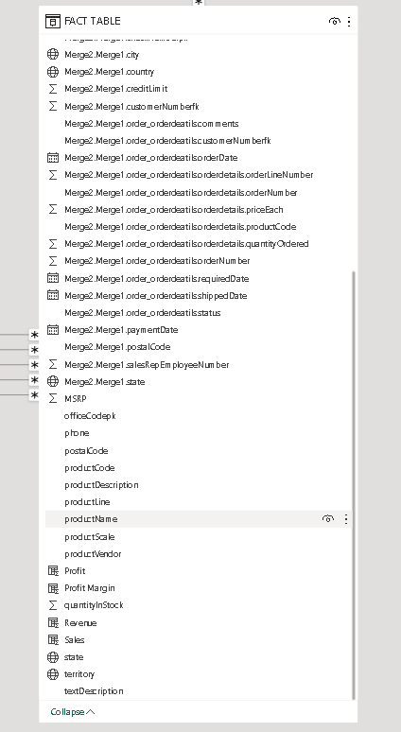

Slide 10
PROBLEM STATEMENT
The objective of this project is to develop a Power BI dashboard using the Retail Database to provide comprehensive insights into the retail business's performance. The dashboard will focus on sales, product, customer, and demographic analysis, aiming to facilitate data-driven decision-making, optimize sales strategies, and enhance customer experiences. The goal is to empower retail stakeholders with actionable insights, enabling them to identify top-selling products, customer preferences, and target demographics. The dashboard will offer valuable insights and recommendations for targeted marketing, inventory optimization, and personalized customer experiences. The final deliverables will include a report and presentation showcasing the dashboard's findings and significance, serving as a powerful tool for retail stakeholders to improve business strategies and achieve success in the competitive retail market.

Slide 11
POWER-BI
PROBLEM STATEMENTS

Slide 12
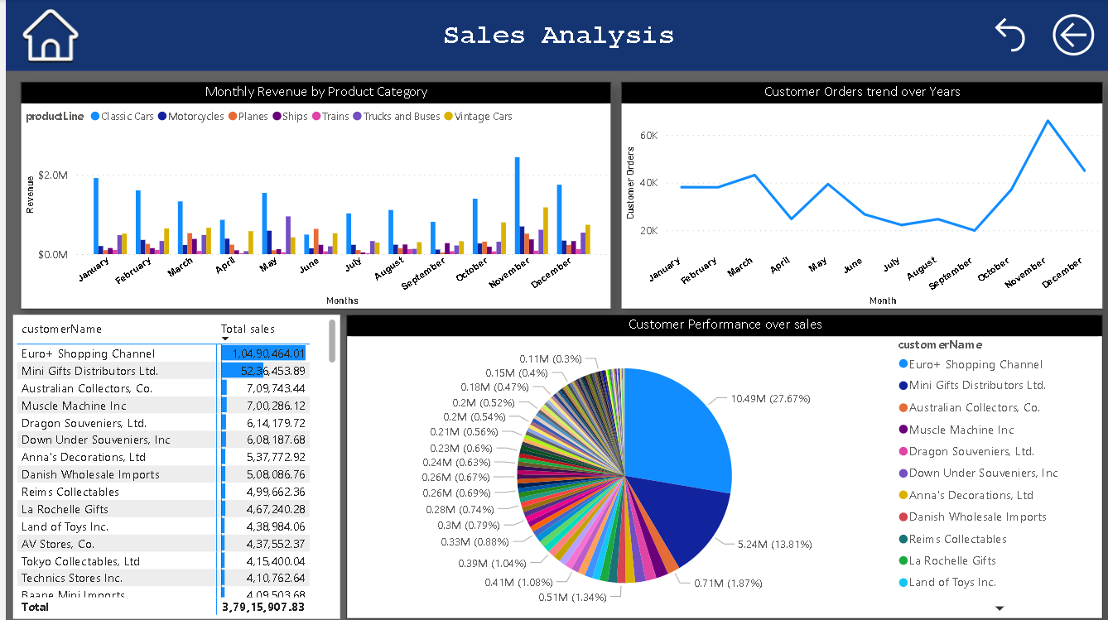

Slide 13
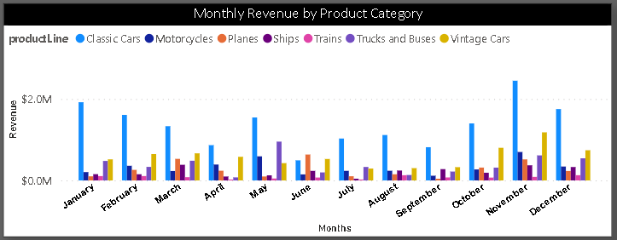
How does monthly revenue vary across different product categories?
Monthly revenue can vary significantly across different product categories and industries. Several factors influence these variations, including consumer demand and market trends.
Consumer Demand: The level of consumer demand for a particular product category can drive monthly revenue fluctuations.
Market Trends and Innovation: Emerging trends and new product innovations can drive fluctuations in monthly revenue.

Slide 14
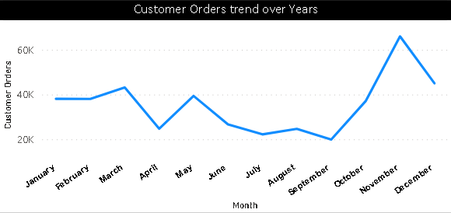
What is the trend in customer order volume over the past year?
This graph illustrates a trend in customer orders over the past few years. It shows that customers tend to place orders at the beginning and end of the year, with the highest number of customer orders occurring in the months of October to December. However, we should focus on the mid-year months, where customer orders are decreasing.

Slide 15
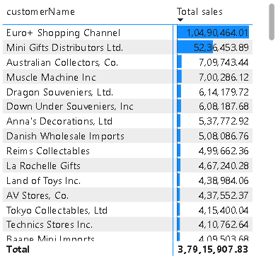
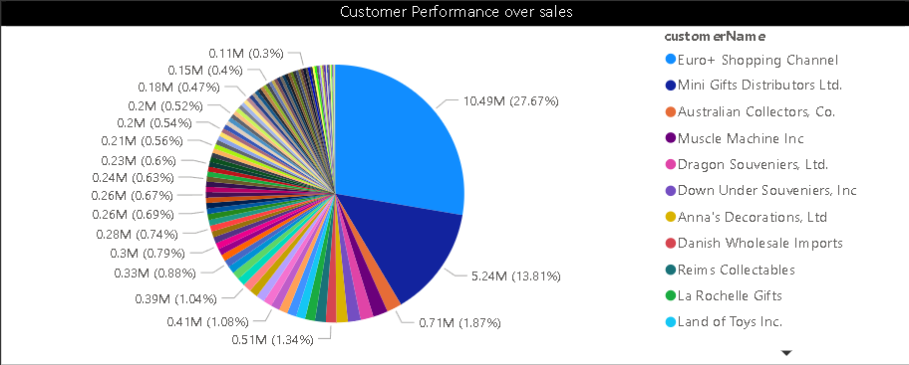
How does the sales performance of top customers compare to the rest?
This graph shows customers with highest sales compare to the rest of customers.
Here are some common comparisons between the sales performance of top customers and the rest:
Revenue Contribution
Order Frequency
Order Size
Loyalty

Slide 16
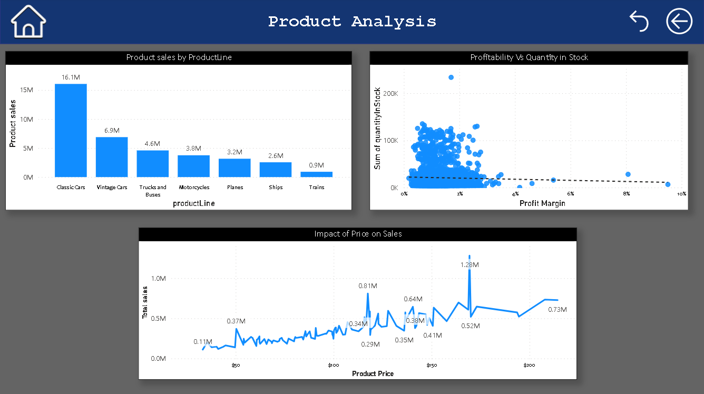

Slide 17
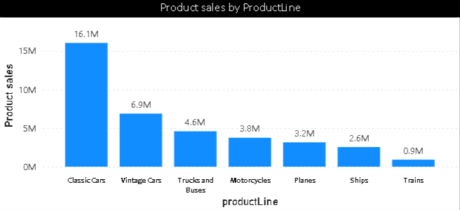
What is the distribution of product sales across different product lines?
This graph shows distribution of product Sales across different product category.
This graph illustrates the market situation for various products, helping us identify specific products where we can focus our efforts to increase sales.

Slide 18
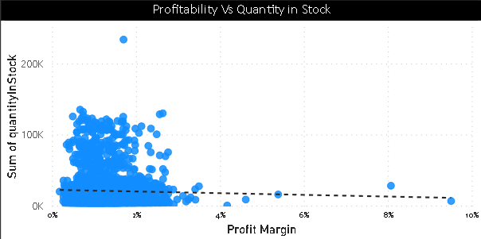
How does the profitability of different products compare based on their quantity in stock?
The profitability of different products can vary based on their quantity in stock. Here are some considerations when comparing the profitability of products in relation to their stock levels:
High Demand, High Stock
Low Demand, Low Stock
Low Demand, High Stock
Product Margins

Slide 19
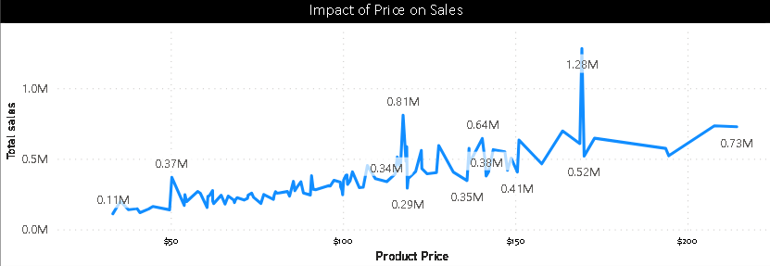
How does product pricing impact sales volume?
Product pricing has a significant impact on sales volume. The relationship between pricing and sales volume is a fundamental aspect of pricing strategy, and it can vary depending on various factors, including the product, market, and consumer behavior. Here are some ways in which product pricing affects sales volume:

Slide 20
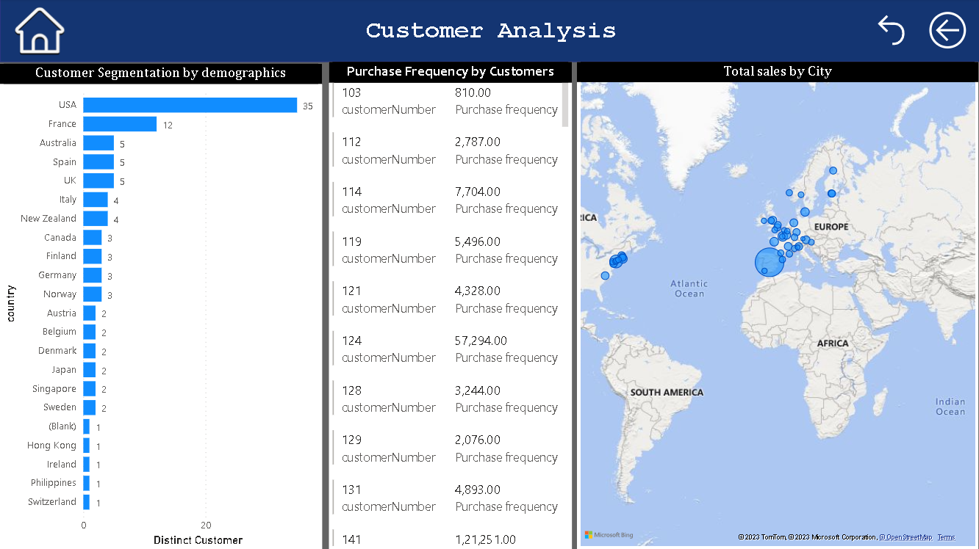

Slide 21
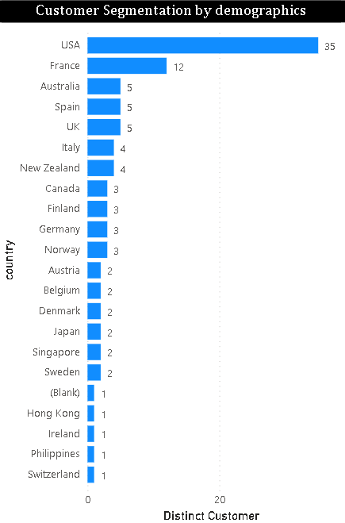
What is the distribution of customers across different demographic segments?
The distribution of customers across different demographic segments refers to how customers are divided or categorized based on various demographic characteristics. Demographic segments typically include factors such as age, gender, income, education level, marital status, location (geographic region), and more. Analyzing this distribution can provide valuable insights into a business's customer base and help tailor marketing, product development, and customer service strategies.

Slide 22
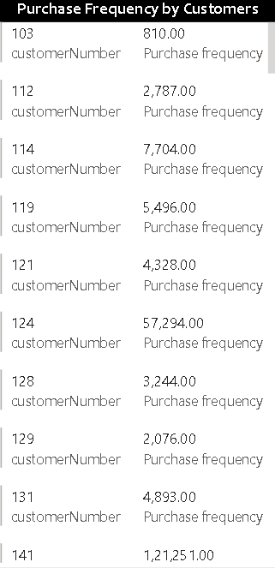
What is the correlation between customer age and purchase frequency?
This graph does not show the correlation between customer age and purchase frequency due to insufficient data, So according to my analysis i create a graph that shows the correlation between customer by purchase frequency.

Slide 23
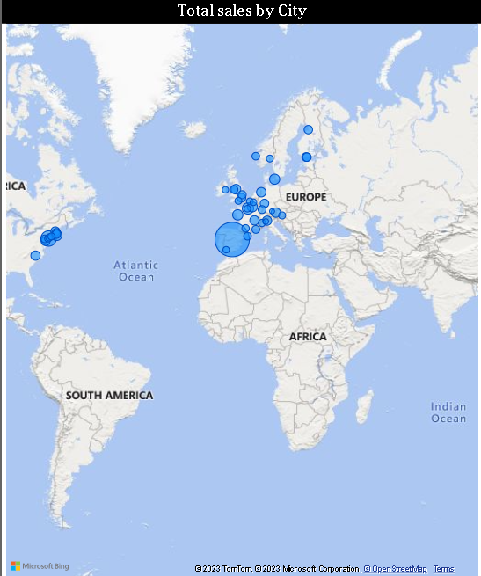
How does customer lifetime value vary for different customer acquisition channels?
Due to insufficient data, we cannot solve this problem, according to the my analysis I create a graph show total sales by city.

Slide 24
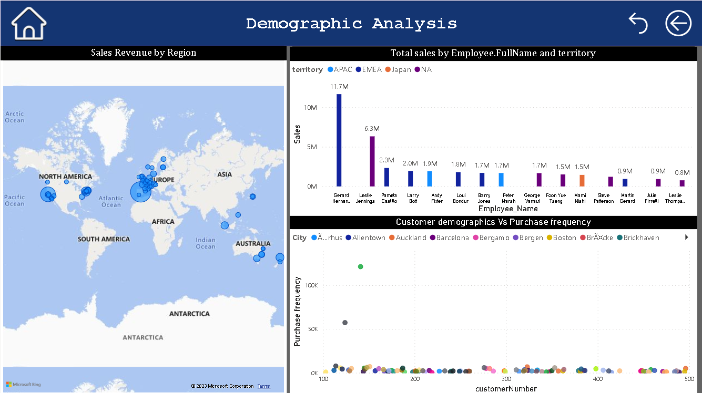

Slide 25
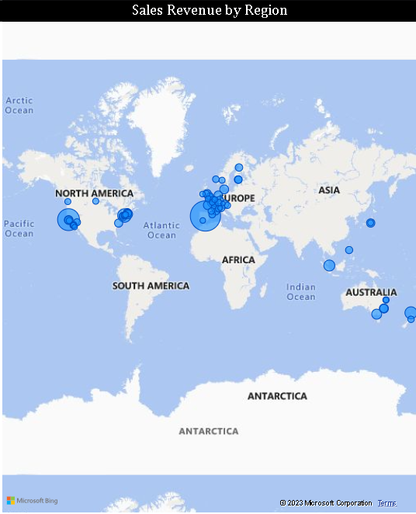
What are the top regions in terms of sales revenue?
This graph shows the top regions in terms of sales revenue. the bubble size shows which region had more sales revenue as compare to others.

Slide 26
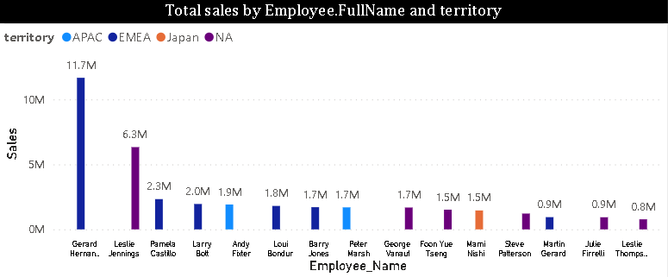
How does the performance of sales employees vary across different regions?
he performance of sales employees can vary significantly across different regions due to a variety of factors. Sales performance is influenced by market conditions, customer demographics.

Slide 27
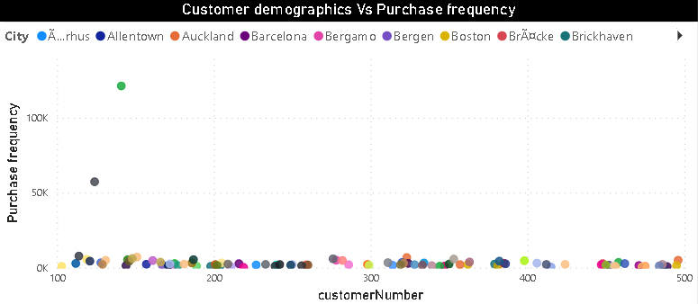
What is the correlation between customer demographics and purchase frequency?
The correlation between customer demographics and purchase frequency can provide valuable insights into consumer behavior. However, it's important to note that the correlation can vary depending on the specific demographic variables being considered and the industry or market in question. According to analysis ‘Mardrid’ and ‘san rafael’ has most purchase frequency than another city.

Slide 28
EXCEL
PROBLEM STATEMENTS

Slide 29
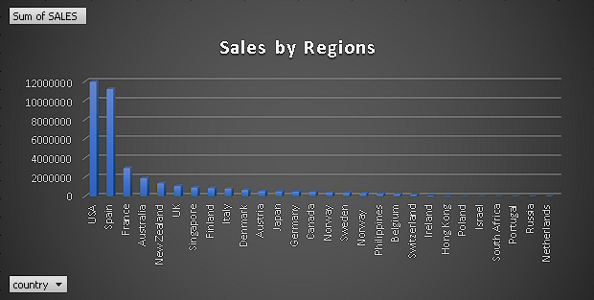
Which factors contribute to the highest sales in a particular region?
This bar chart displays sales data across various regions, making it easy to discern sales patterns. It clearly indicates that the "USA" stands out as the region with the highest sales, amounting to approximately "1.2 million." This chart also facilitates the identification of both the highest and lowest sales figures among the regions.
Here are some of the factors that impact regional sales:
1)No of Customers
2) Credit limit

Slide 30
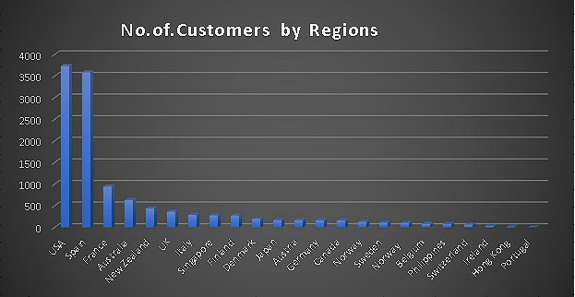
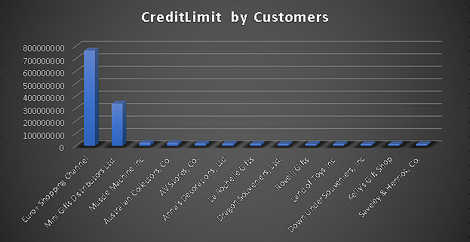
Factors contribute the highest sales in a particular region
Here are some of the factors that impact regional sales:
1)No of Customers
2) Credit limit

Slide 31
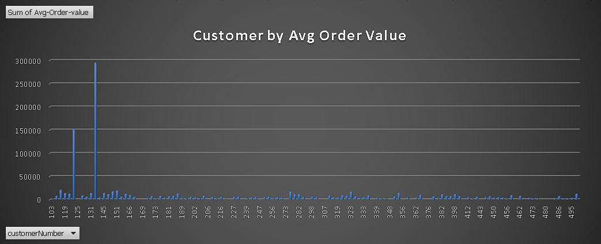
Which factors contribute to the highest sales in a particular region?
This graph shows the average order value for each customers, with the x-axis represents customer number such as "103","124",etc.
The Y-axis represents sum of the Average Order value with value ranging from 0 to 300000.

Slide 32
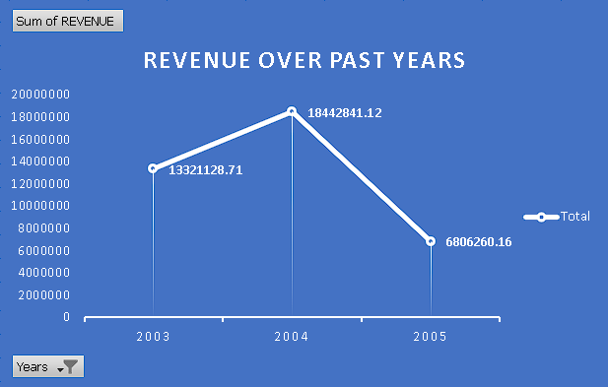
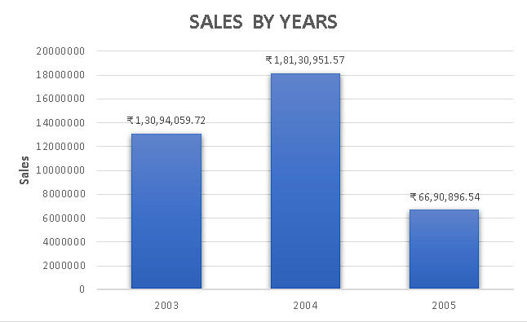
What are the key drivers of sales growth, and how can they be leveraged for future success?
This graph shows the revenue over past years and sales over past years,
making it easy to discern growth of sales over past years.
KEY drivers for sales growth: -
1)Revenues of at least $5 million in the most recent year.
2)CAGR of 25% or more over the last 3 years.

Slide 33
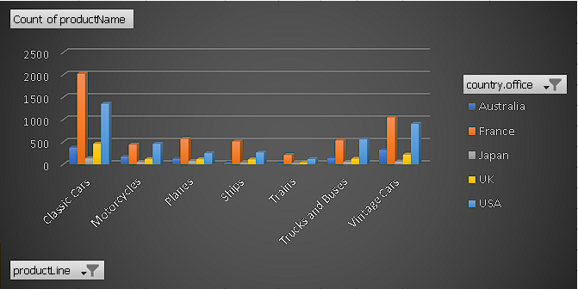
How can the product mix be optimized to cater to changing market demands?
Product Mix: Product Mix refers to all product lines(Product Category) and items a company has for sales (Product quantity).
Product Mix can be changed according to market situation, like if a product in particular productline is not doing good sales in the market we reduce number of product according to the market demand and start focusing on product which has more demand in market.
First graph shows demand of products across different country.
Second graph shows where we need to focus and cater according to demand of market.

Slide 34
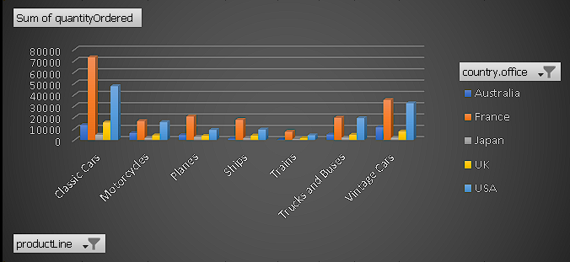
How can the product mix be optimized to cater to changing market demands?
Product Mix: Product Mix refers to all product lines(Product Category) and items a company has for sales (Product quantity).
Product Mix can be changed according to market situation, like if a product in particular productline is not doing good sales in the market we reduce number of product according to the market demand and start focusing on product which has more demand in market.
First graph shows demand of products across different country.
Second graph shows where we need to focus and cater according to demand of market.

Slide 35
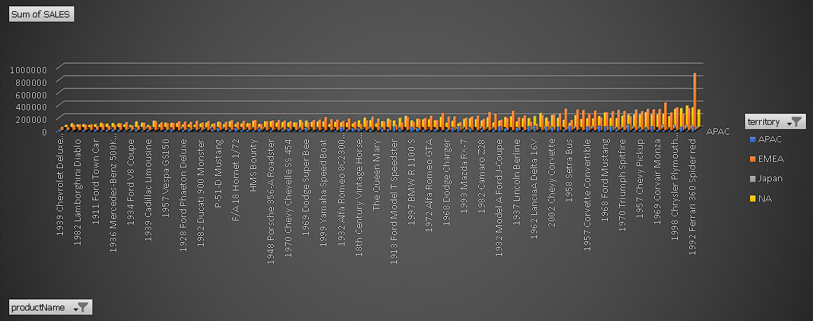
Are there any specific market segments where a particular product is underperforming, and how can it be improved?
This graph displays the product with the lowest sales in the market segment, which is the 1939 Chevrolet Deluxe Coupe, located at the far end of the X-axis. Based on our analysis, we can implement several strategies to address its underperformance:
1. Offering discounts to customers for bulk orders.
2. Investing in product advertising on social media platforms.
3. Providing free shipping for orders exceeding a certain quantity."

Slide 36
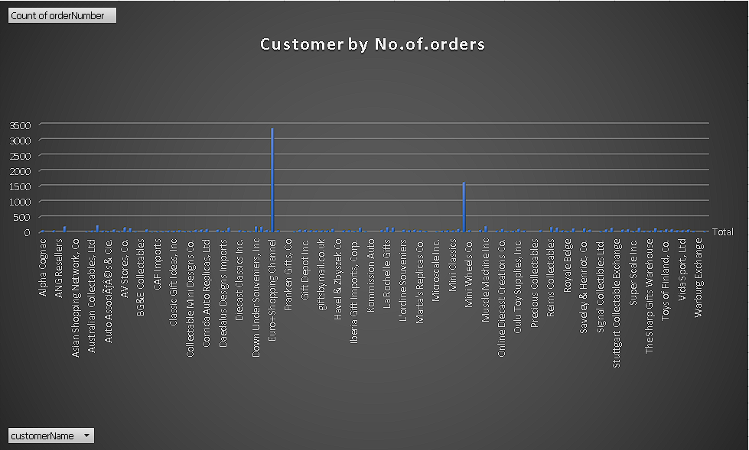
What are the main factors that influence customer loyalty and repeat purchases?
The graph does not effectively represent customer behavior based on repeated orders due to incomplete data. However, according to my analysis, customers who place a greater number of orders tend to exhibit higher interest in the product and greater confidence in its quality. Additionally, customers with higher order quantities may indicate stronger product demand within a specific market segment.

Slide 37
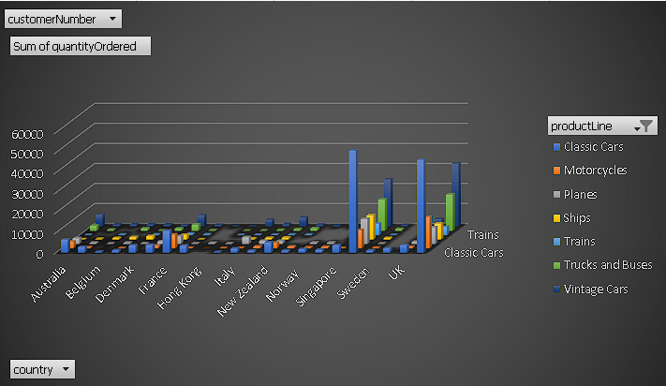
How do customer preferences differ based on geographic location, and how can marketing campaigns be customized accordingly?
The graph reveals that customer preferences vary by location, and it suggests that we should prioritize customers who frequently order a specific product. We should create targeted advertisements that align with their preferences to encourage more purchases and introduce them to a wider range of products available in the market. Additionally, we should analyze local competition and adjust our marketing strategies to better meet the unique needs of customers in each region, helping us stand out in local markets.

Slide 38
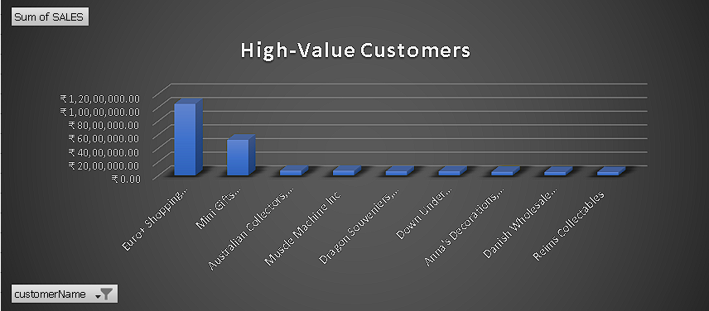
What are the characteristics of high-value customers, and how can similar customers be targeted for acquisition?
This graph shows High_value Customer, with the X-axis
repersent Customer and Y-axis represent sales. this graph show top customer with higest sales this customer worth the most to brand.
High-value Customer are those who rely on your product or services more than others customers and bring in more business in the long run.
To target customers for acquisition, you can offer various incentives and perks such as providing them with exclusive product reviews for newly launched items, offering pre-order options, giving discounts on bulk orders, and providing free shipping.

Slide 39
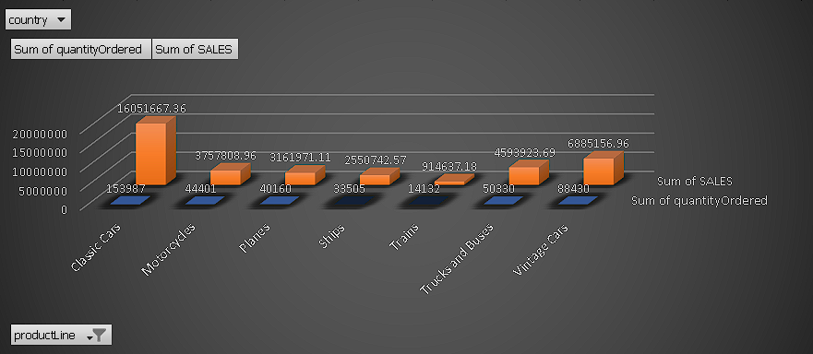
How can marketing strategies be tailored to target specific demographic segments in different regions?
This graph illustrates purchase patterns across various regions, and we have incorporated a country slicer for in-depth analysis of sales trends in different areas. After analyzing the purchase patterns across these regions, we can implement targeted marketing strategies. These strategies may include offering multiple promotional offers, discounts, free shipping options, and exclusive deals for bulk orders. The aim is to convert potential customers into actual customers by leveraging these marketing strategies effectively.
1)Word of mouth Marketing.
2)Paid Marketing.
3)Diversity Marketing.

Slide 40
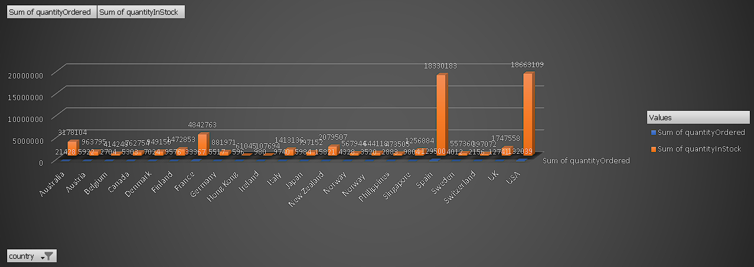
What are the potential untapped markets based on demographic indicators, and how can market penetration be increased?
Untapped Markets is a demand for a product or service that isn't being supplied by any company yet.
Demographic Indicators are statistics that describe the characteristics of a population.
Market Penetration refers to the successful selling of a good or services in a specific market.
This graph shows the demand of product across different regions, and we analyze that 'USA' and 'SPAIN' has good market penetration. X- axis represent regions and Y-axis represent Quantity in stock and Ordered Quantity.

Slide 41
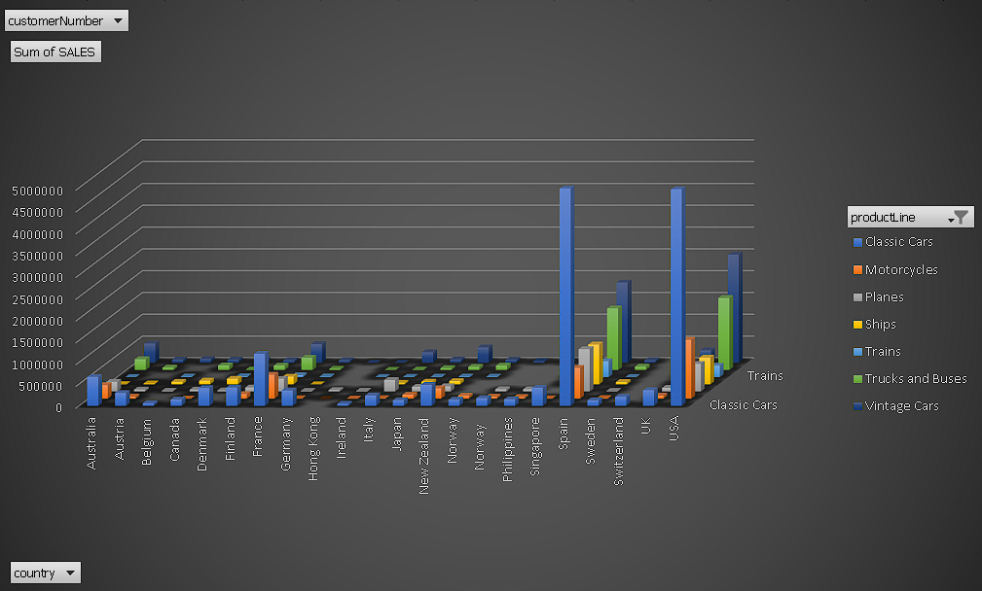
How do customer preferences and behavior differ based on demographic factors, and how can they be leveraged for personalized marketing campaigns?
The graph reveals that customer preferences vary by location, and it suggests that we should prioritize customers who frequently order a specific product. We should create targeted advertisements that align with their preferences to encourage more purchases and introduce them to a wider range of products available in the market. Additionally, we should analyze local competition and adjust our Personalized marketing strategies to better meet the unique needs of customers, helping us stand out in local markets.
Personalized marketing strategies that we can use to Improved Customer Experience, Drive Revenue, Increase Brand Loyalty,
Create Consistency Across Channels.

Slide 42
CONCLUSIONS
The development of a Power BI dashboard and EDA using the Retail Database is a crucial initiative aimed at revolutionizing the retail business's performance. By focusing on sales, product, customer, and demographic analysis, this project seeks to empower retail stakeholders with data-driven decision-making capabilities. The dashboard's primary goal is to optimize sales strategies, enhance customer experiences, and facilitate targeted marketing efforts. As we finalize the project, we anticipate delivering a comprehensive report and presentation that will not only showcase the dashboard's findings but also highlight its significance as a powerful tool for retail stakeholders. With these actionable insights, retail businesses can improve their strategies and stay competitive in the dynamic and ever-evolving retail market. This project represents a significant step toward achieving success in the retail industry by leveraging the power of data analytics.

